Slide 1
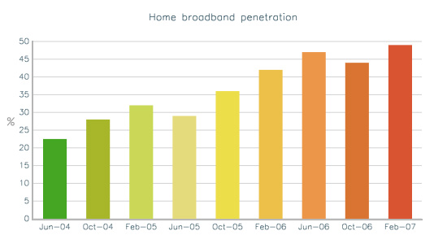
EXPLORATORY DATA ANALYSIS
ON
ENERGY DATASET

Slide 2
LIBRARIES USED
1. Matplotlib
2. Seaborn
3.Plotly
4.Missingno
5.Cufflinks

Slide 3
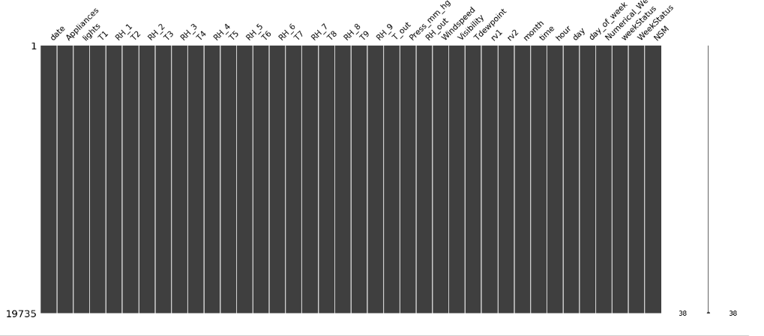
NO MISSING VALUES

Slide 4
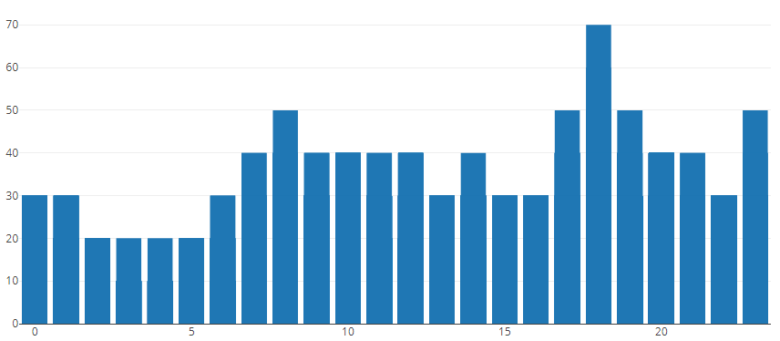
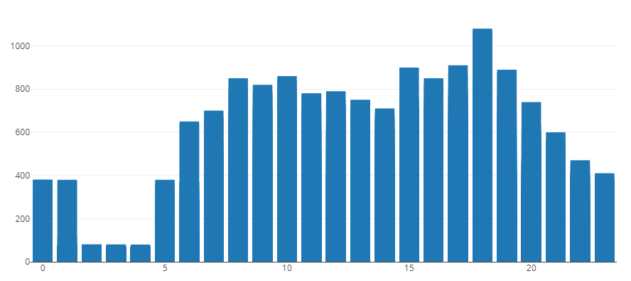
OVERALL ANALYSIS OF LIGHTS AND APPLIANCES
LIGHTS
APPLIANCES
BOTH THE CASES SHOW A SIMILAR PATTERN. THERE IS A HIKE IN THE PATTERN BETWEEN 5PM TO 9PM.

Slide 5
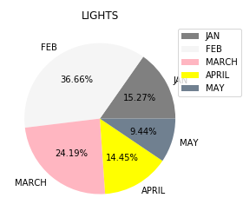
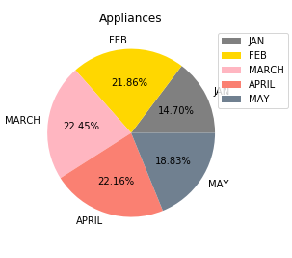
ANALYSING APPLIANCES EACH MONTH
IN THIS WE CAN SEE THAT MARCH HAS CONTRIBUTED MORE TO THE APPLIANCES USAGE COMPARED TO OTHER MONTHS.
IN CASE OF LIGHTS , FEBRUARY HAS USED MORE.

Slide 6
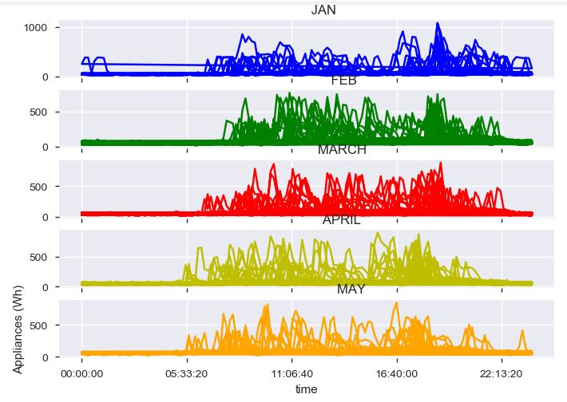
ANALYSING APPLIANCES CONSUMPTION EACH MONTH WITH RESPECT TO TIME
MAXIMUM CONSUMPTION OF ENERGY IS BETWEEN 5 PM TO 9PM.

Slide 7
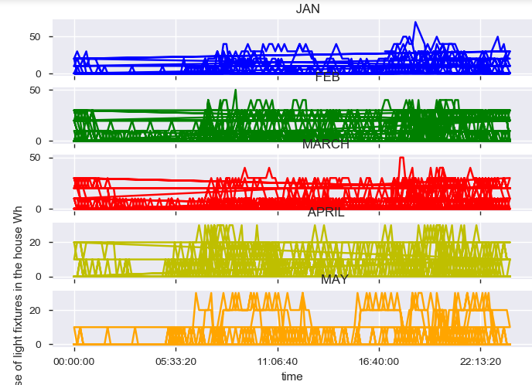
ANALYSING LIGHTS WITH RESPECT TO TIME
WE CAN SEE A HIKE IN THE SAME TIME INTERVAL AS THAT OF APPLIANCES IN LIGHTS TOO.

Slide 8
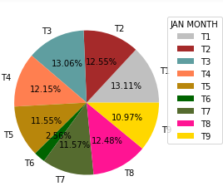
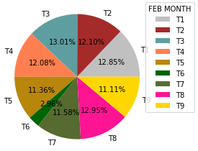
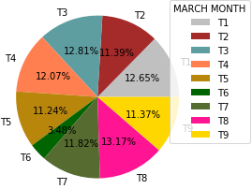
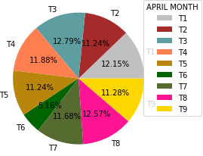
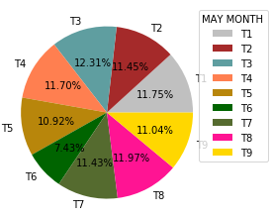
From these charts , we can conclude that T6 has contributed the least for the month of Jan , Feb and March and we can see a sudden increase in the contribution for the month April and May which indicates that there is a increase in the outside temperature.
March showed as the highest consumption of energy ; In March we have the less value for T6.

Slide 9
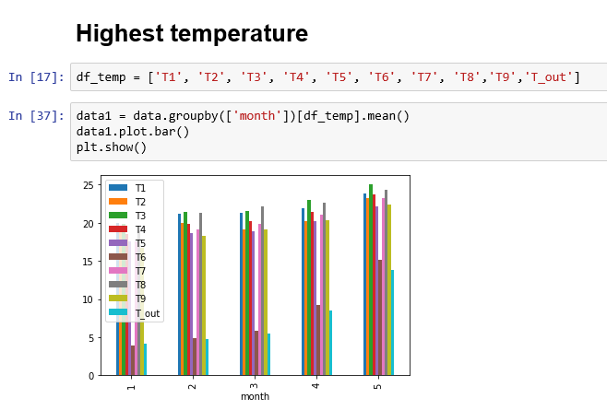
Calculating the highest temperature per month basis gives the result that month 5 i.e MAY is having the maximum temperature.

Slide 10
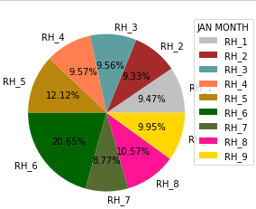
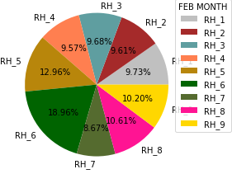
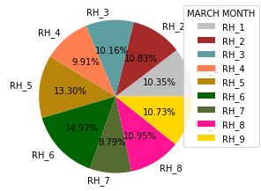
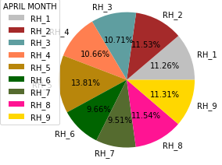
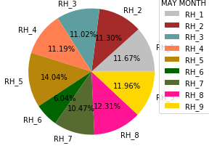
RH_6 has contributed the most in month of Jan , Feb and March and a sudden decrease in humidity can be seen in case of April and May.
From this we can conclude that temperature and humidity are inversely proportional.
From temperature and humidity charts , we can say that rh_6 and T6 might have an impact on appliances.

Slide 11
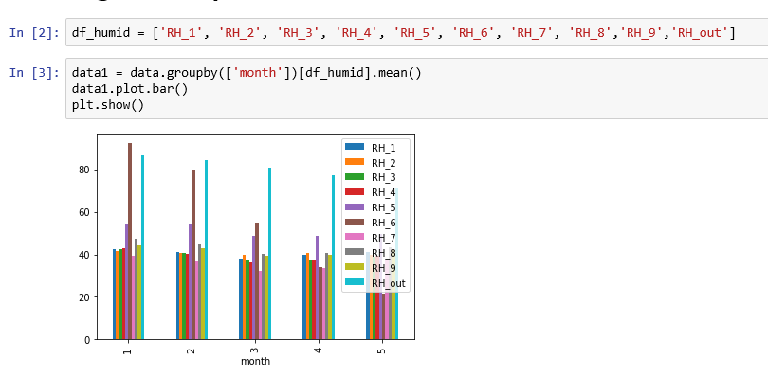
Calculating the highest humidity per month basis gives the result that month 1 i.e JANUARY is having the maximum humidity

Slide 12
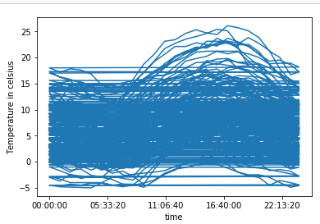
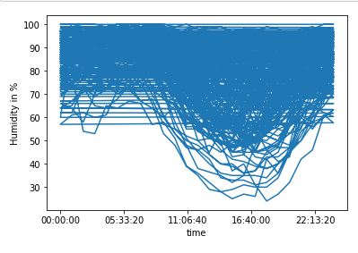
ANALYSIS OF T_out AND RH_out WITH RESPECT TO TIME
THE TREND SEEN IN THIS PLOT IS SAME AS THAT OF APPLIANCES.
SO THERE IS A POSSIBILITY THAT THEY HAVE SOME IMPACT ON THE APPLIANCES.

Slide 13
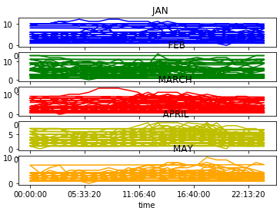
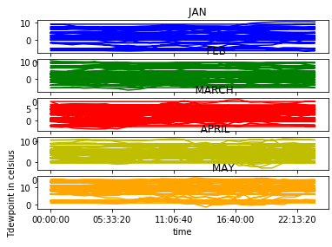
COMPARING WINDSPEED WITH Tdewpoint
IIRRESPECTIVE OF THE TIME , THE DATAPOINTS ARE NOT CHANGING IN BOTH THE CASES WHICH IMPLIES THAT THEY DO NOT INFLUENCE THE APPLIANCES AT ALL.

Slide 14
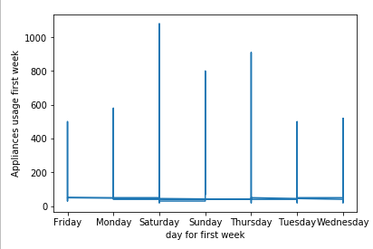
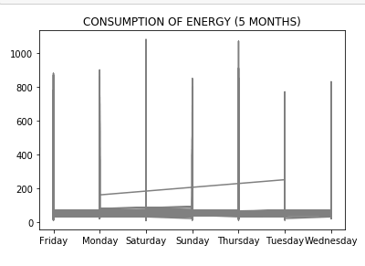
ANALYSIS BASED ON DAYS
SATURDAY AND THURSDAY HAS THE MAXIMUM CONSUMPTION OF ENERGY.

Slide 15
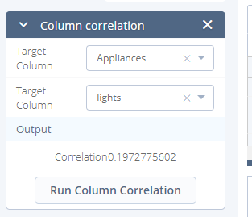
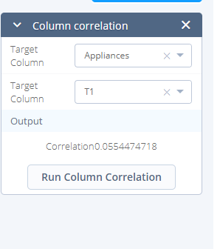
Column Correlation for individual Features

Slide 16
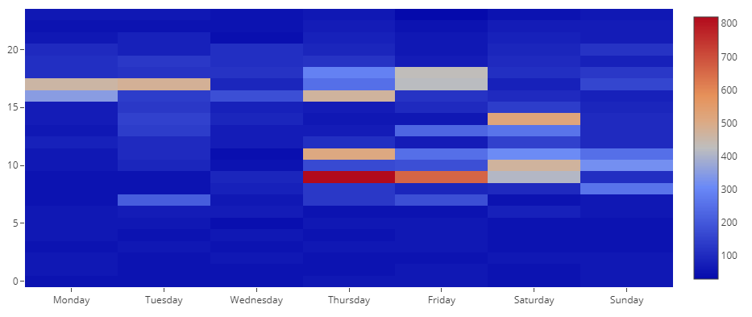
HEATMAP ANALLYSIS WITH APPLIANCES
THIS PLOT SHOWS HOW MUCH ENERGY IS CONSUMED EACH DAY FOR A PERIOD OF 5 MONTHS FOR A PERIOD OF 24 HOURS.

Slide 17
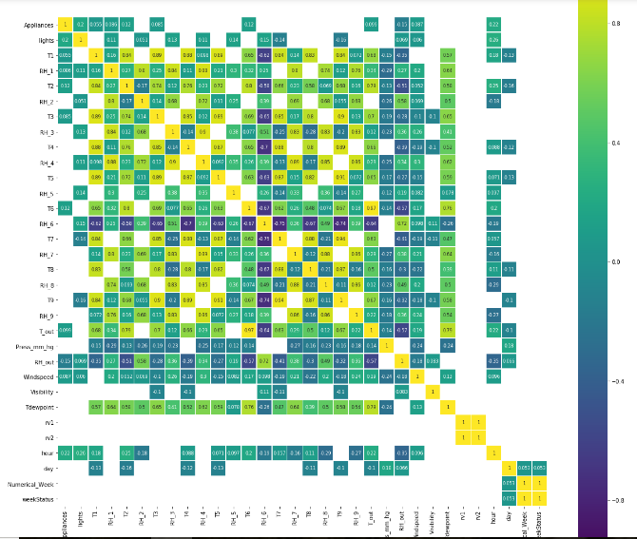
This is a heatmap which shows the correlation of all the variables.
Here , values >0.05 is considered as factors that influence other variables. Anything less that that will be represented with blank spaces.

